Slide 1
Cabling

Slide 2
Cabling (1 of 5)
Types of Cables
Patch cable – a relatively short length of cabling with connectors at both ends
Horizontal cabling – connects workstations to the closest data room and to switches housed in the room
Backbone cabling – consists of cables or wireless links that provide interconnection between the entrance facility and MDF and between MDF and IDFs
Many network problems are the result of poor cable installations
Pay close attention to the quality of cable connections and cable management

Slide 3
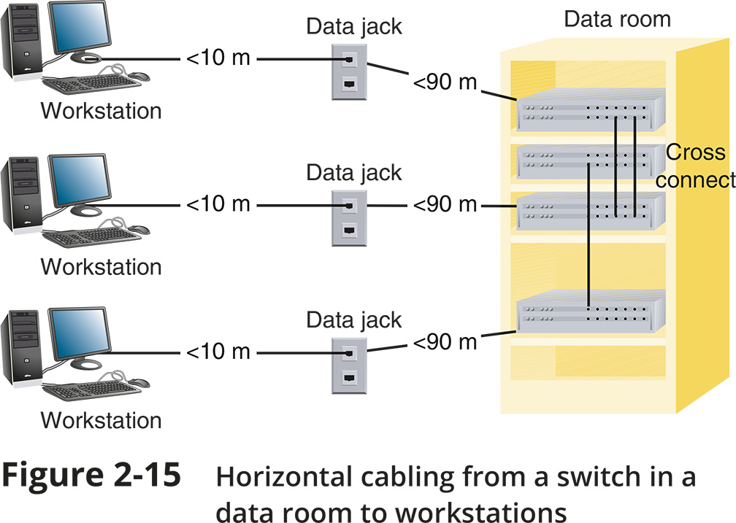
Cabling (2 of 5)

Slide 4
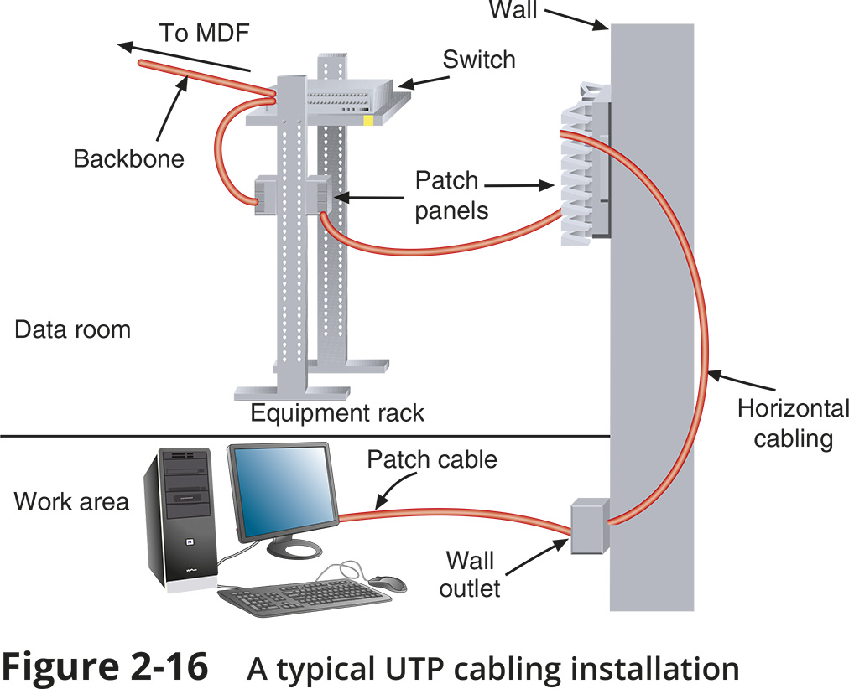
Cabling (3 of 5)

Slide 5
Cabling (4 of 5)
Cable Management
Termination – when terminating twisted-pair cabling, don’t leave more than 1 inch of exposed cable before a termination
Bend radius – do not exceed the cable’s prescribed bend radius, which is the radius of the maximum arc into which you can loop a cable without impairing data transmission
Continuity – use a cable tester to verify that each cable segment transmits data reliably
Loosely cinch cables

Slide 6
Cabling (4 of 5)
Cable Management
Cable coverings and conduits – avoid laying cables across a floor and use cord covers if they must be exposed
EMI sources – install cable at least 3 feet away from fluorescent lights or other sources of EMI (electromagnetic interference)
Plenum cabling – if running cable in the plenum (the area above the ceiling tile or below subflooring), make sure the cable sheath is plenum-rated

Slide 7
Cabling (5 of 5)
Cable Management (continued)
Grounding - pay attention to grounding requirements
Slack in cable runs
Cable trays - use cable management devices such as cable trays, braided sleeving, and furniture grommets
Patch panels - use patch panels to organise and connect lines
Company standards and inventory
Documentation
Keep your cable plant documentation accessible
Label every data jack or port, patch panel and connector
Use color-coded cables for different purposes
Update your documentation as you make changes to the network

